Slide 1
The Lessons of Log4shell
Preparing for the Next Zero-Day

Slide 2

Hello World
Paul Novarese
Principal Solutions Architect
Anchore, Inc.
github.com/pvnovarese
Fediverse: @pvn@mas.to
Notes:
Anchore is working to secure the software supply chain
We sponsor open source projects SYFT and GRYPE

Slide 3
Agenda
00
The Silver Bullet
01
Lesson 1
02
Lesson 2
03
Lesson 3
Notes:
I’m not going to give away all the good stuff here on the first slide

Slide 4

Notes:
Everyone wants a silver bullet, there’s not one
This isn’t a utopian talk
There is a lot of bad news

Slide 5
Lesson 1:
When
Notes:
I’m going to start with the bad news and slowly get to the better news
WHEN

Slide 6
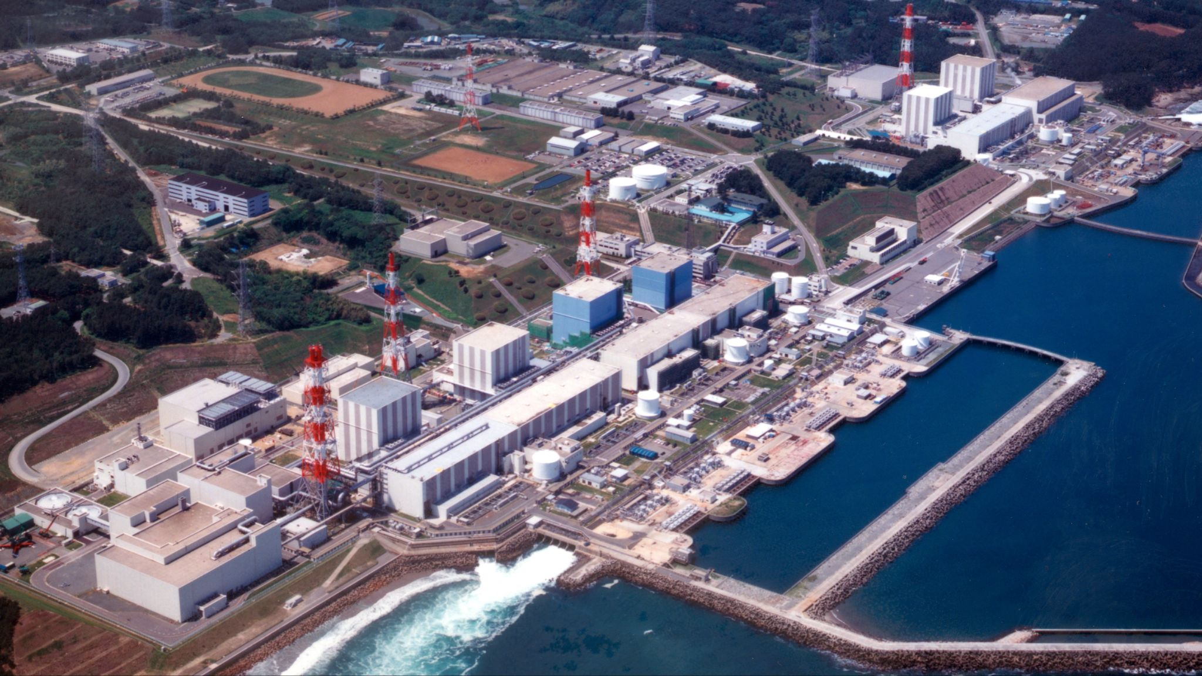
Fukishima Daiichi
Incident: 2011
Cleanup: at LEAST thirty years
Notes:
Fukishima Daiichi
Incident: 2011
Cleanup: at LEAST thirty years

Slide 7
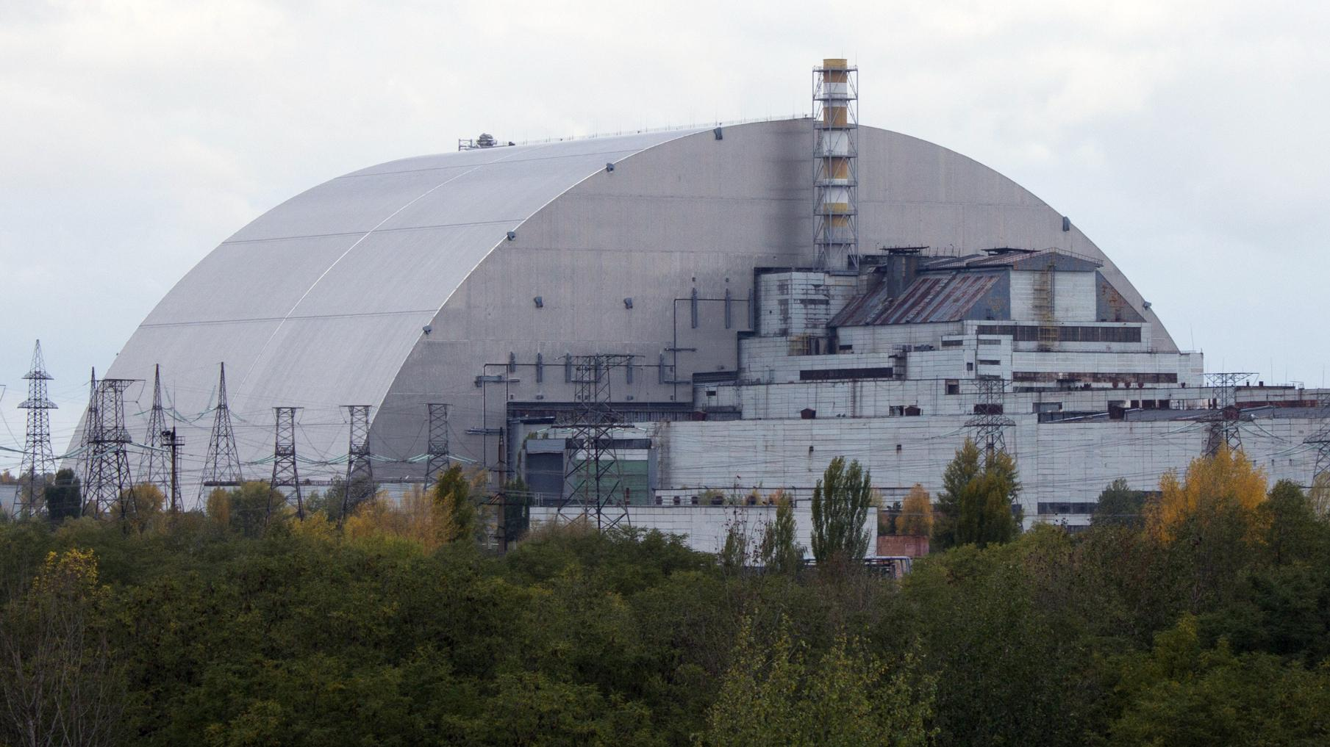
Chernobyl
Incident: 1986
Cleanup: at LEAST until 2065
Notes:
Chernobyl
Incident: 1986
Cleanup: at LEAST until 2065

Slide 8
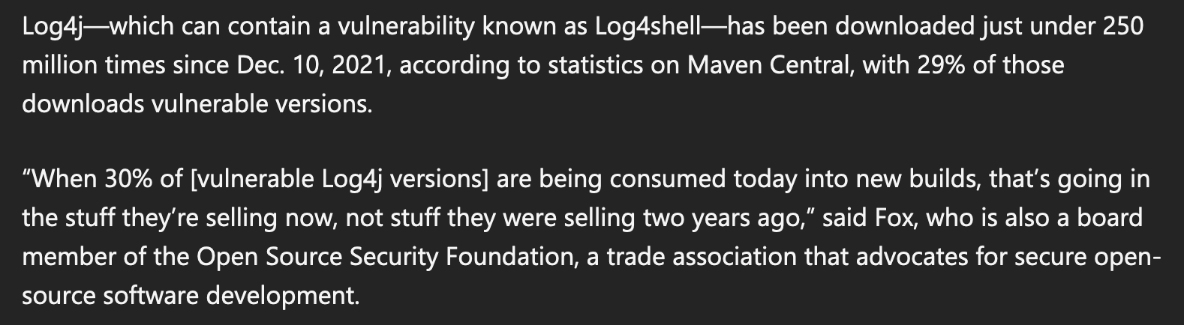
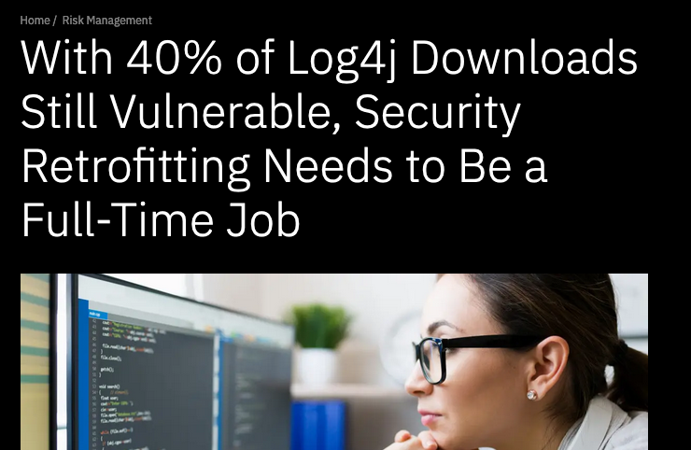
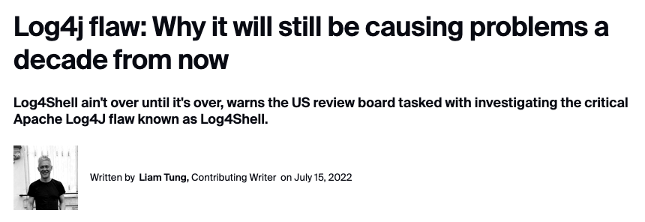
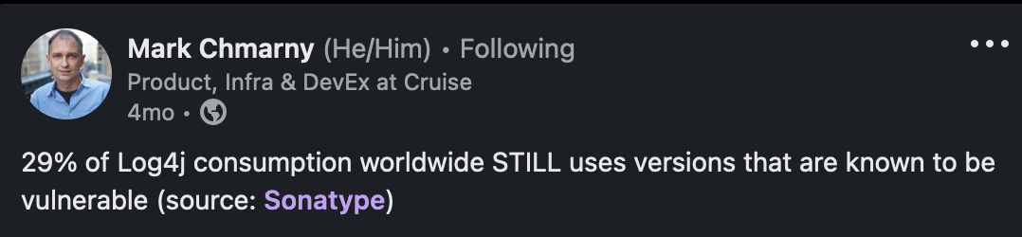
Notes:
In 2023: 40% of Log4j downloads still vulnerable it will still be causing problems a decade from now
So… WHEN will we be done? Effectively never.

Slide 9
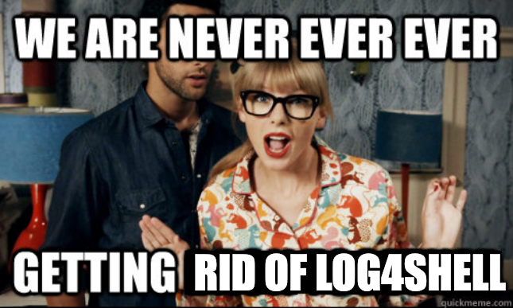
Notes:
In 2023: 40% of Log4j downloads still vulnerable
it will still be causing problems a decade from now
Fukishima: 2011
Chernobyl: 1986

Slide 10
Lesson 2:
What

Slide 11

Hidden Risk in the Software Supply Chain
Your App
Software suppliers
60% contain
high risk vulnerabilities
Risk in the Software Supply Chain
Log4j
Attackers are targeting here
Open source
makes up 75%
of applications
Notes:
You’ve seen this iceberg metaphor. I’ve used this metaphor 100 times, I’ve criticized this metaphor.
They’re attacking the bottom now - that’s a supply chain attack

Slide 12
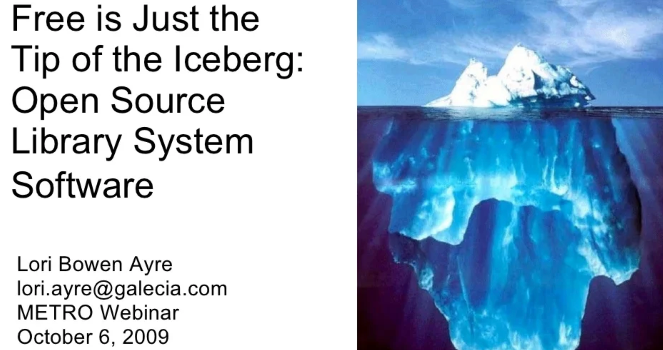
Notes:
This is an OLD metaphor (At LEAST 2009, with that EXACT image)
Things have changed a lot but we’re still thinking about old systems
https://www.slideshare.net/loriayre/open-source-library-system-software-free-is-just-the-tip-of-the-iceberg

Slide 13
Direct Dependencies
Attackers are targeting here
Transitive
Dependencies
Notes:
The top isn’t “your code” - attackers don’t care about your code at all, the top is your direct dependencies
You can only directly control what’s at the top
They’re attacking all of those, but you probably only know about the stuff at the top
We just build software differently now than when this metaphor was invented

Slide 14
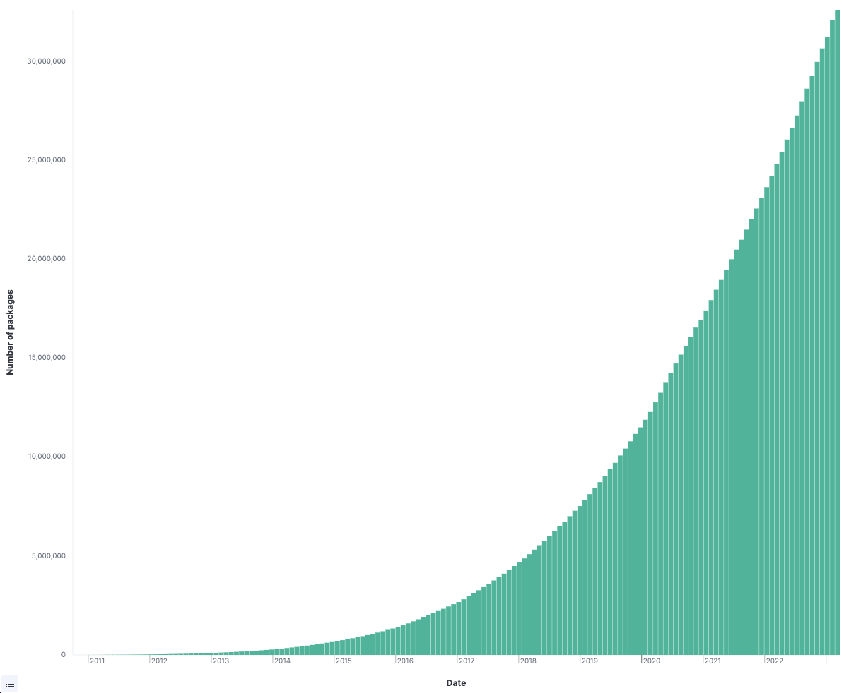
Number of
NPM packages
Notes:
NPM introduced 2010
32 million packages
As of march 2023

Slide 15
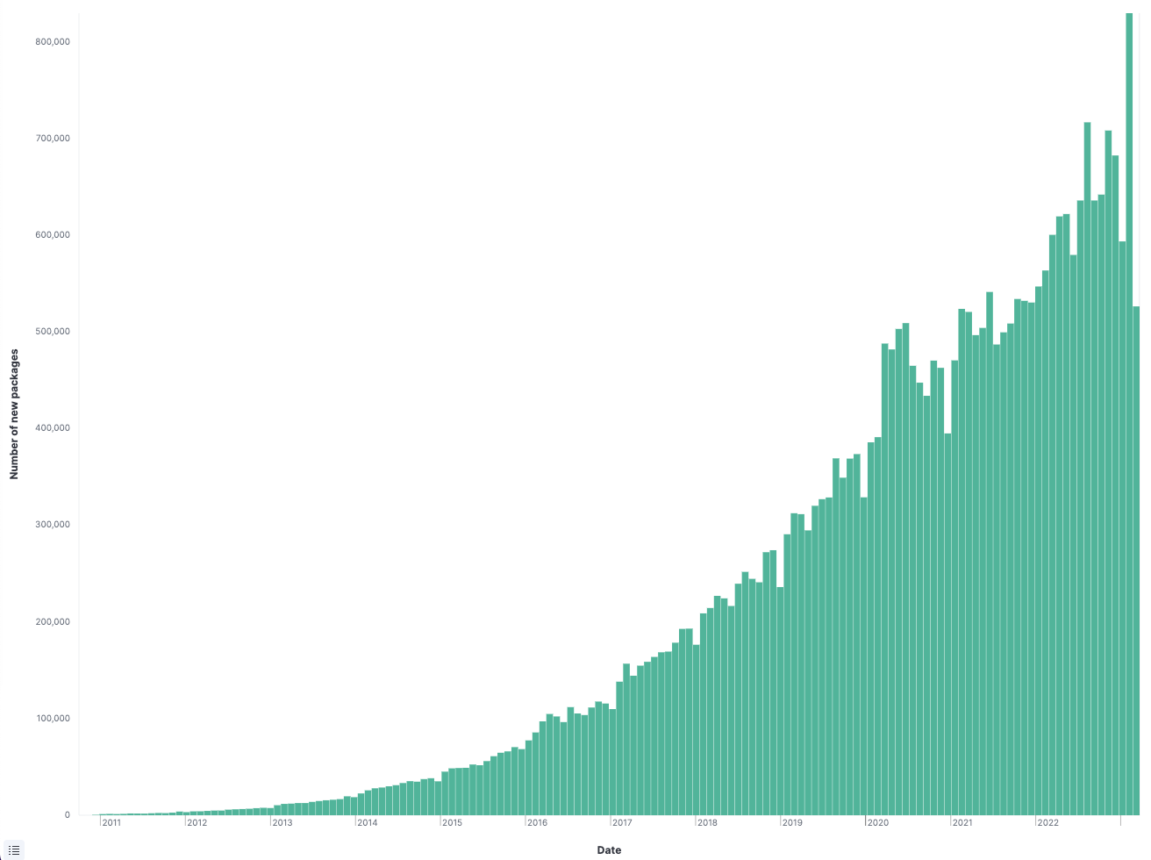
Number of
NEW packages
Notes:
Approaching 1,000,000 new packages per month
Proposal to do security reviews on 10,000 open source projects per year
All of this explosion has led up to…

Slide 16
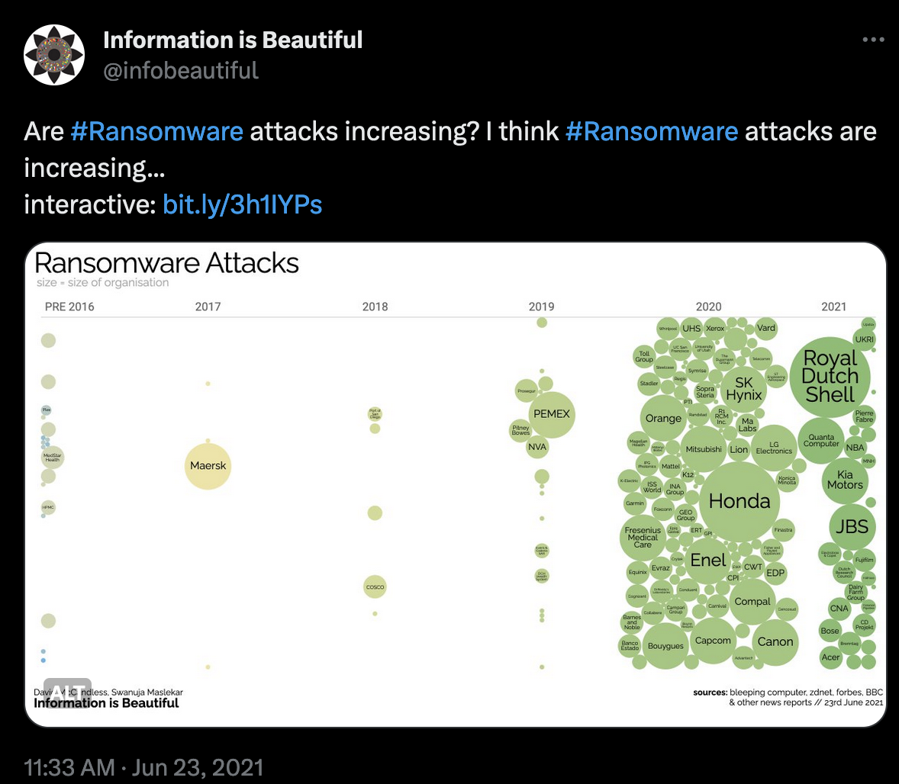
Notes:
https://twitter.com/infobeautiful/status/1407738511265050626
Predictable consequence: HUGE increase in supply chain attacks
This is tightly correlated with the explosion in transitive deps
I don’t believe in coincidences

Slide 17
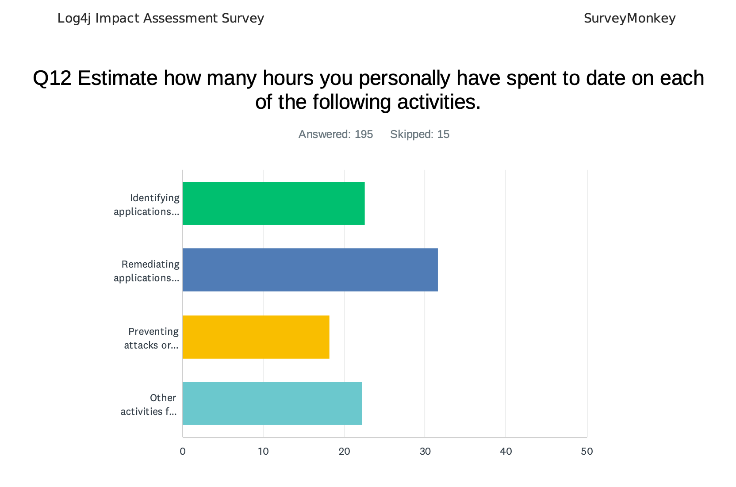
Notes:
Note: only 65% of respondents indicated that “identifying applications” was part of their role in log4j response.
We could fix stuff faster
SBOMs help, a LOT, but…
They aren’t a silver bullet
Scanners aren’t perfect (can’t penetrate all binary blobs)
Not all SBOMs are equal
SBOMs aren’t ubiquitous (yet) Nobody really supplies SBOMs (yet) and it’s not easy to consume them when producing your own SBOMs
SBOMs are more accurate when the supplier produces them
SBOM Management is hard
Not really clear what the end game is but generating them is better than doing nothing, figure out the details later
Any SBOM generated before an actual build is suspect (transitive deps)
SBOM everywhere

Slide 18
Lesson 3:
Who
Notes:
Ok we talked about what you’re consuming, next is who are you getting it from?

Slide 19
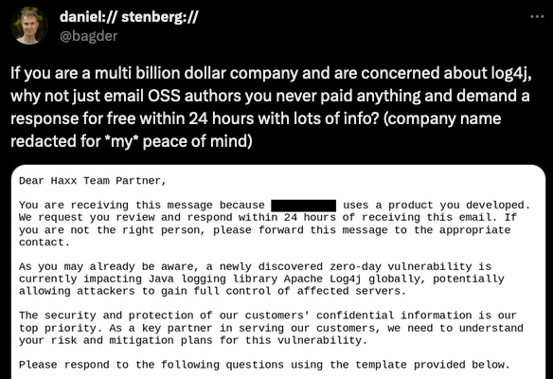
Notes:
https://twitter.com/bagder/status/1484672924036616195
Does everyone know who daniel is?
This guy is NOT your supplier
He has tons of these stories, he’s not unique

Slide 20


Stop thinking about open source like a vendor
This
Not this
Notes:
Open Source is a RESOURCE, not a VENDOR
You can’t yell at the tree because you don’t like the wood.
You CAN yell at a vendor who is processing trees and selling you lumber

Slide 21
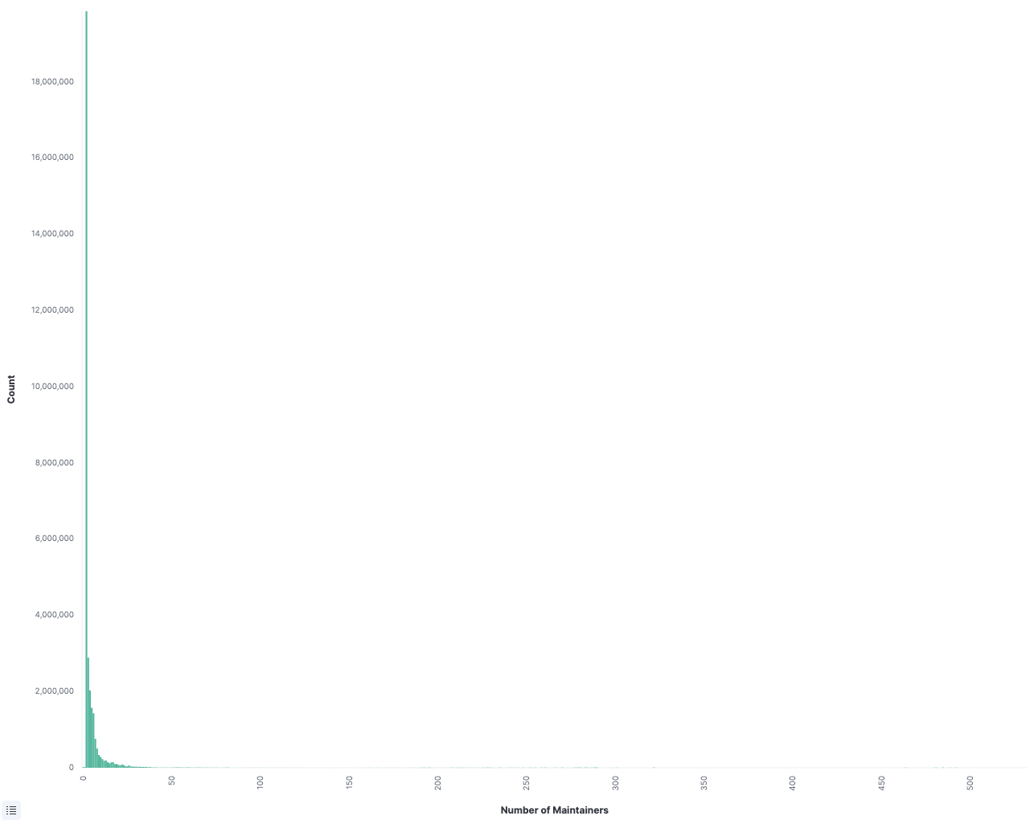
THIS IS NOT
THE AXIS!
Number of
Maintainers
Notes:
There are a LOT of single-maintainer projects out there, and you’re probably consuming a lot of them
This brings us to the last lesson:

Slide 22
Lesson 3:
How
Notes:
Ok finally, how are we going to make sense of this and move forward?

Slide 23
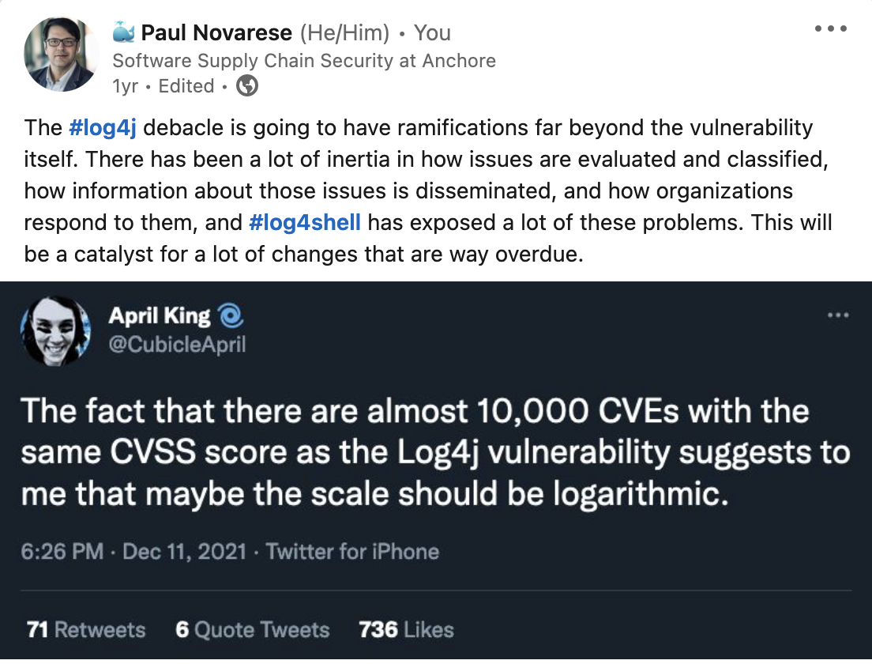
Notes:
I posted this in December 2021 right after log4shell dropped, a year later I basically gave up and said this was completely wrong, and now another year later I think it may end up being correct, ultimately.
CVSS Scores are getting to be like NPS scores, everything is effectively a 10 or a 0.
Having a scale from 0 to 10 projects nuance and sophistication
But nobody is actually doing the work necessary to determine impacts with that level of granularity

Slide 24
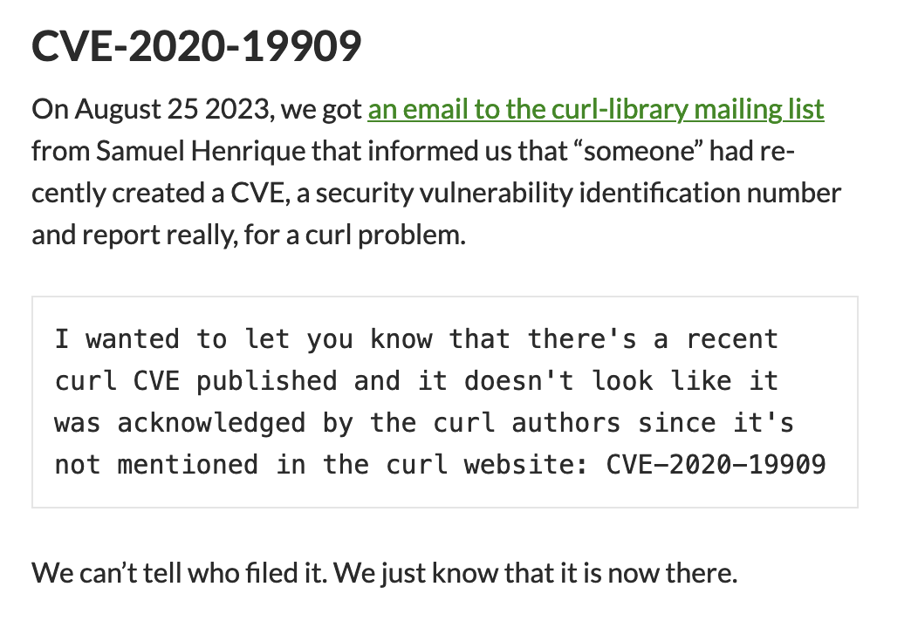
Notes:
Let’s go back and talk about Curl again
Here’s a recent blog post from daniel
There is no transparency or accountability (It’s a 2020 advisory just filed in 2023)
The score is not connected to reality (9.8!)
It’s not even a security vulnerability!
OK, If Not CVSS, Then What?
GHSAs
(Github advisories start with CVE data but enhance it, there’s a transparent process for discussion and refinement)
CISA KEV
EPSS
VEX
GitHub Insights and other project health metrics

Slide 25
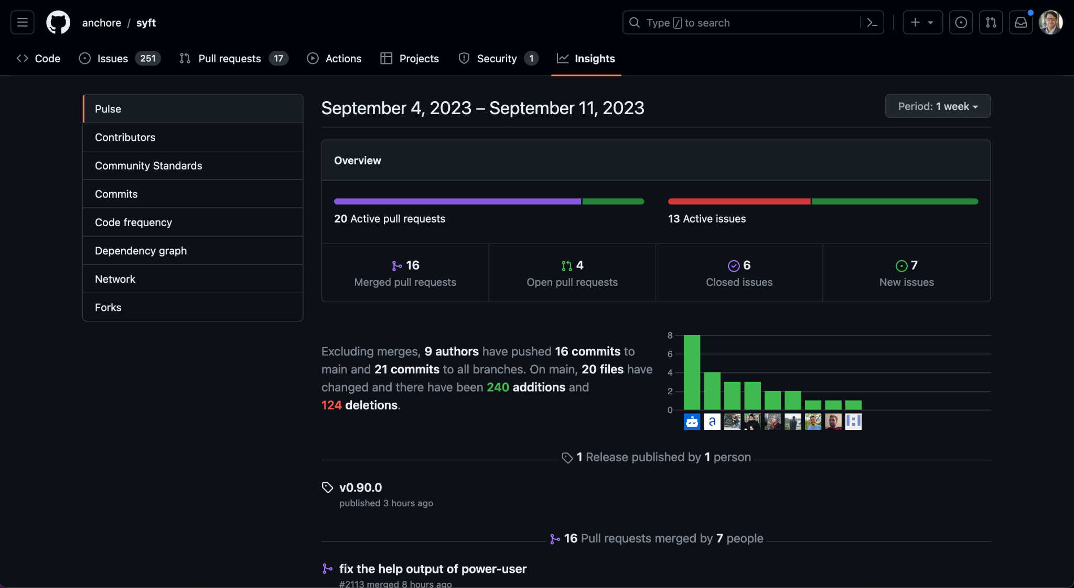
Notes:
Project Health
This is (currently) largely a manual process
But it’s getting a lot easier
I see a lot of people asking for more data like this but they want stuff like positive IDs on contributors
They think they can find boogeymen putting traps into open source
But Evaluating project health isn’t directly about safety
What happens when it hits the fan?
Are the projects you’re depending on healthy, will the be able to react, can you work with them?

Slide 26
Recap, Notes, &c.

Slide 27
Recap
Log4Shell is radioactive and immortal
How software gets made has changed
We don’t know what’s in our software
We don’t know who is supplying it
We have to change how we evaluate it
GitHub is uniquely positioned
Think about risk in the general case
Notes:
It’s hard to know what’s in our own software, it’s even harder for other people’s software
Radioative disasters take forever to clean up
The data we consume today is bad, but improvements are emerging

Slide 28
Q&A
Download Syft
Download Grype
https://github.com/anchore/syft
https://github.com/anchore/grype
Let us know if you like it by giving us a star on GitHub
Get an invite to our open source community Slack at https://anchore.com/slack/
These slides and lab examples archived here:
https://github.com/pvnovarese/2023-09-lessons-of-log4shell

Slide 29
Footnotes
Slide 6 (Log4Shell will still be causing problems a decade from now): https://www.zdnet.com/article/log4j-flaw-why-it-will-still-be-causing-problems-a-decade-from-now/
Slide 6 (40% of Log4j downloads still vulnerable): https://securityintelligence.com/articles/log4j-downloads-vulnerable/
Slide 10 (possible origin of the iceberg): https://www.slideshare.net/loriayre/open-source-library-system-software-free-is-just-the-tip-of-the-iceberg
Slides 12,13, 22 (Open Source is Bigger Than You Can Imagine): https://anchore.com/blog/open-source-is-bigger-than-you-imagine/
Slide 14 (log4j survey etc): https://anchore.com/log4j/
Slide 18: https://twitter.com/CubicleApril/status/1469825942684160004 https://www.linkedin.com/posts/novarese_log4j-log4shell-activity-6876206319238463488-8bEA
Slide 26: https://twitter.com/bagder/status/1484672924036616195 https://lists.haxx.se/pipermail/daniel/2023-September/000032.html

Slide 30
Reading List
GitHub Advisory Database: https://github.com/advisories
GitHub Insights: https://docs.github.com/en/issues/planning-and-tracking-with-projects/viewing-insights-from-your-project/about-insights-for-projects
CVEs CWEs CVSS and It's Discontents https://www.linkedin.com/pulse/cves-cwes-cvss-its-discontents-sherif-mansour
Open Source Security Podcast Episode 392 – Curl and the calamity of CVE https://opensourcesecurity.io/2023/09/10/episode-392-curl-and-the-calamity-of-cve/
I am not a Supplier: https://www.softwaremaxims.com/blog/not-a-supplier https://opensourcesecuritypodcast.libsyn.com/episode-365-i-am-not-your-supplier-with-thomas-depierre
Shedding Light on CVSS Scoring Inconsistencies https://arxiv.org/abs/2308.15259
My previous DevOpsDays 2022 talk (Learn From Log4Shell): https://www.youtube.com/watch?v=PlNtIL_oN0k https://github.com/pvnovarese/2022-devopsdays
Probably Don’t Rely on EPSS Yet https://insights.sei.cmu.edu/blog/probably-dont-rely-on-epss-yet/
CVE-2020-19909 is everything that is wrong with CVEs https://daniel.haxx.se/blog/2023/08/26/cve-2020-19909-is-everything-that-is-wrong-with-cves/
CISA Known Exploited Vulnerability Catalog https://www.cisa.gov/known-exploited-vulnerabilities-catalog
Exploit Prediction Scoring System https://www.first.org/epss/
Do SBOMS Need VEX? https://www.linkedin.com/posts/aph10_sbom-softwaresupplychainsecurity-vex-activity-7108017924384137216-VARV/

Slide 31
Log4Shell Reading List
Dealing with log4shell (detection, mitigation, workarounds): https://cloudsecurityalliance.org/blog/2021/12/14/dealing-with-log4shell-aka-cve-2021-44228-aka-the-log4j-version-2/
Keeping up with log4shell (post mortem) https://cloudsecurityalliance.org/blog/2021/12/16/keeping-up-with-log4shell-aka-cve-2021-44228-aka-the-log4j-version-2/
Mysterious tweet hinting at the exploit: https://twitter.com/sirifu4k1/status/1468951859381485573
Another mysterious tweet: https://twitter.com/CattusGlavo/status/1469010118163374089
“THE” pull request: https://github.com/apache/logging-log4j2/pull/608
Cloudflare digs for evidence of pre-disclosure exploits in the wild: https://twitter.com/eastdakota/status/1469800951351427073

Slide 32
Appendix A
Additional Bonus Slides

Slide 33


Quick Aside
Notes:
https://joshdata.me/iceberger.html

Slide 34

Notes:
https://twitter.com/K_LDivergence/status/1337171919448182786

